Slide 1

Coal 101 - Industry Overview
  Extraction
  Processing
  Transport
  Utilization

Slide 2
Energy from Coal

Slide 3
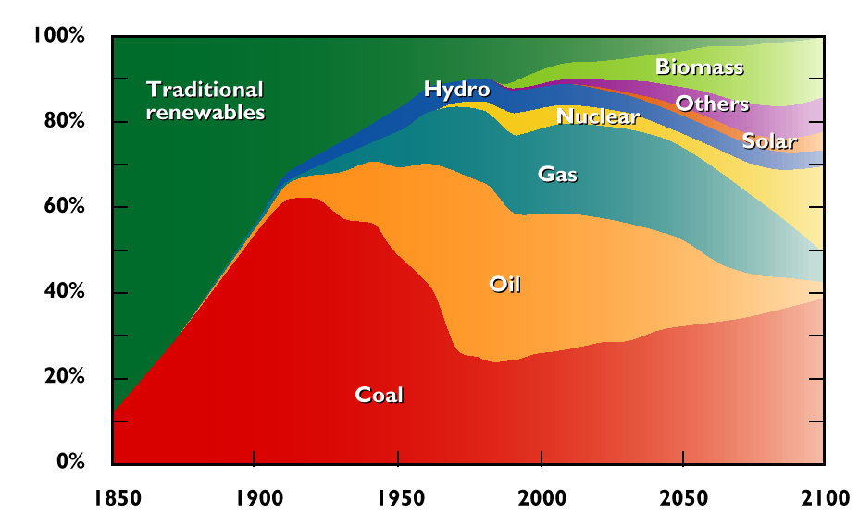
Global Energy Sources

Slide 4
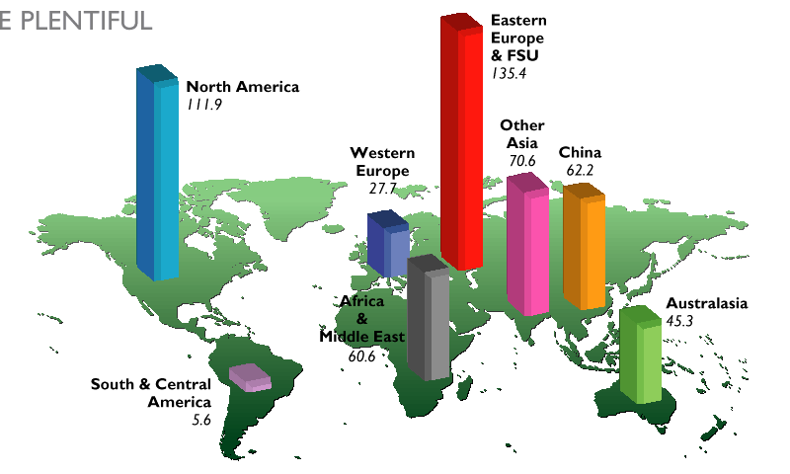
World Coal Reserves, 1998

Slide 5
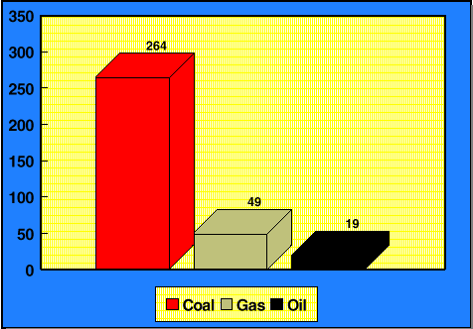
US Energy Reserves (years to depletion)

Slide 6
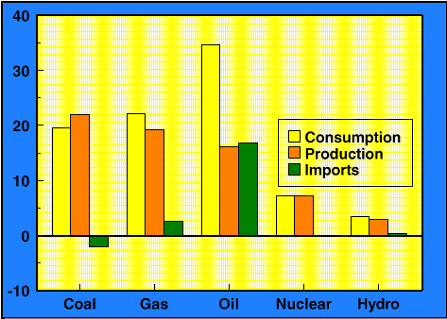
US Energy Overview (1995)

Slide 7
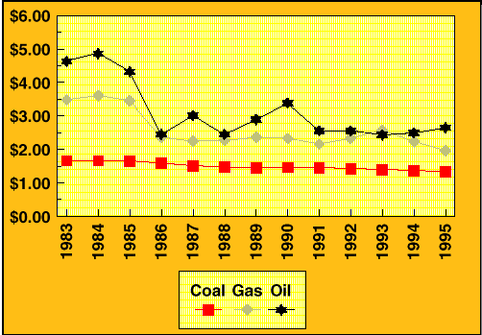
Delivered Cost of Fuel to Power Utilities

Slide 8
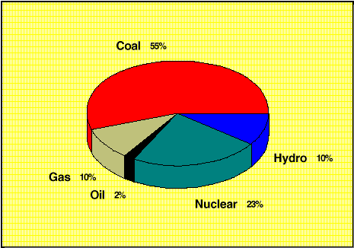
US Electricity Generation

Slide 9
Types of Coal

Slide 10
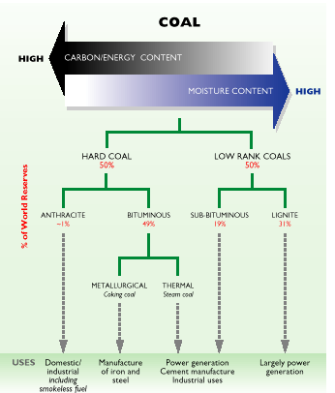
Coal Rank
Anthracite
Bituminous
Sub-bituminous
Lignite

Slide 11
Coal Types
COAL TYPE
CHARACTERISTICS
Steam (thermal) coal
Metallurgical (coking) coal
Compliance coal
Low-ash coal
Low-sulfur coal
Used in boilers to generate steam (e.g. for generating electricity)
Coal that can be converted into coke. Must have low ash and sulfur and form a strong base
Meets S02 emission standards
Contains < 8% ash by weight
Contains < 1% sulfur by weight

Slide 12
Coal Grade
Size (in)
Anthracite
Bituminous
8
4
3
2
1
0.5
0.2
0.1
0.05
Run of Mine
Broken
Egg
Stove
Chestnut
Pea
Buckwheat #1
Buckwheat #2 (Rice)
Buckwheat #3 (Barley)
Buckwheat #4
Buckwheat #5
Lump
Nut
Stoker
Slack

Slide 13
Coal Mining

Slide 14
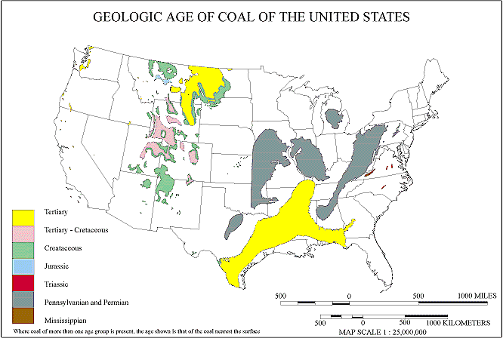
US Coal Mining Regions
WESTERN
INTERIOR
APPALACHIAN
TEXAS

Slide 15
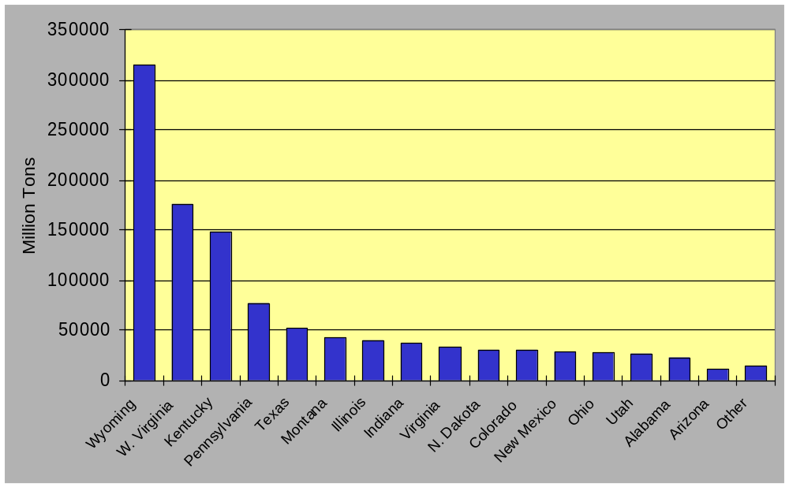
US Coal Production by State (1998)

Slide 16
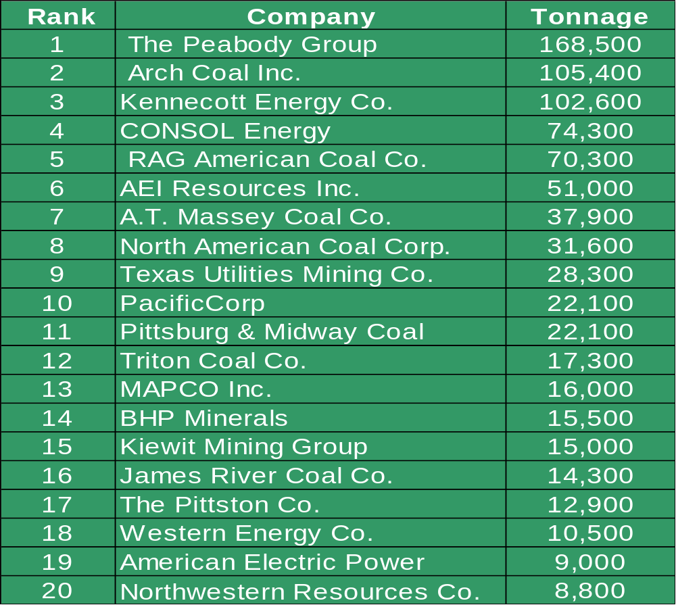
Major US Coal Producers (1998)

Slide 17
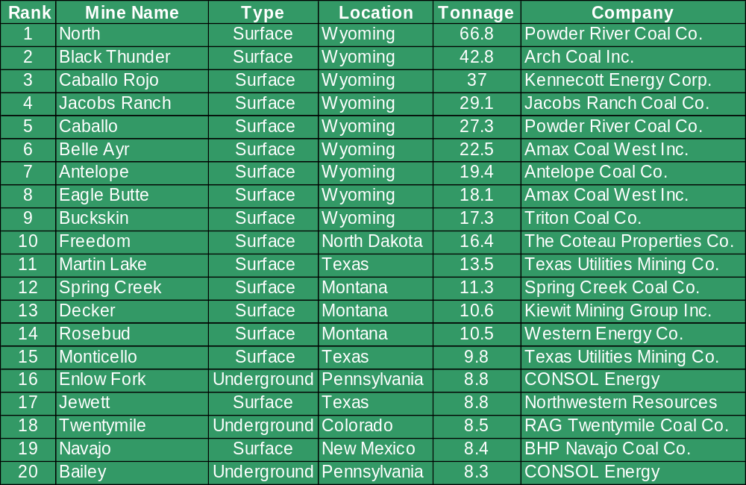
Major US Coal Mines (1998)
N. Antelope/Roch

Slide 18
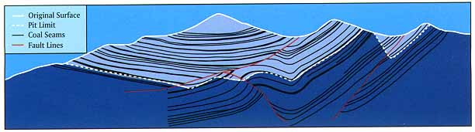
Coal Extraction
Surface Mining
Mountaintop Mining
Underground Mining

Slide 19
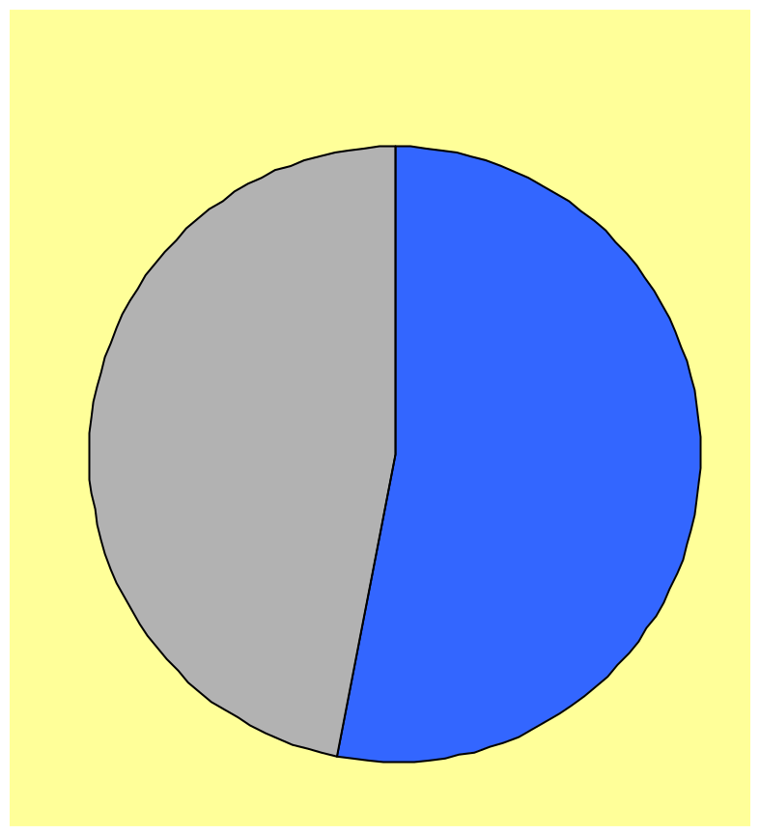
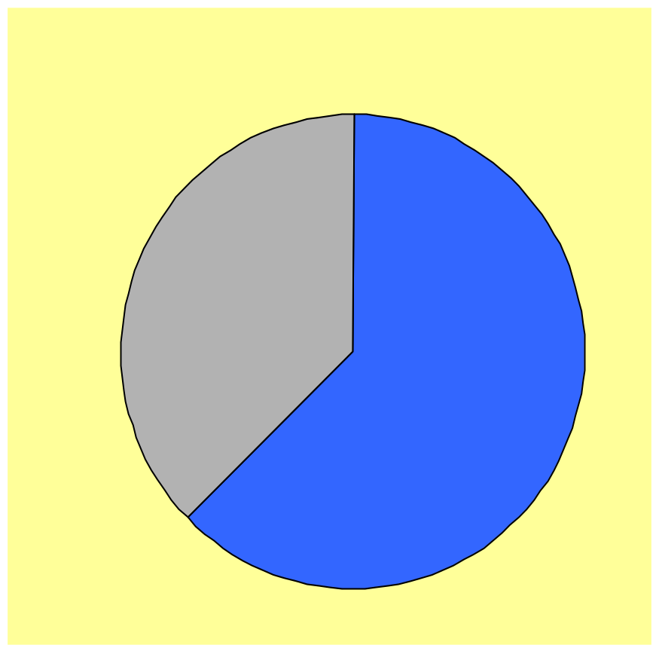
Types of US Coal Mine (1998)
NUMBER OF MINES
OUTPUT FROM MINES
Underground
Underground
(560)
(37%)
Surface
Surface
(63%)
(630)

Slide 20
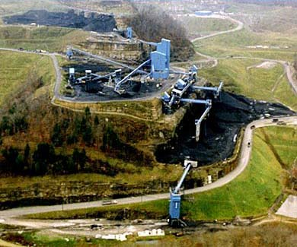
TECO Mine

Slide 21
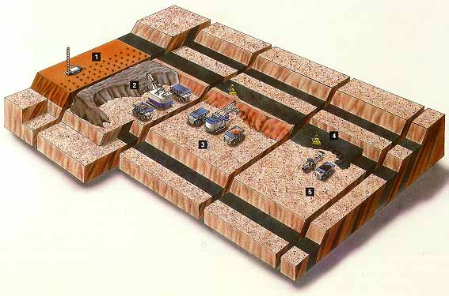
Surface Mining

Slide 22
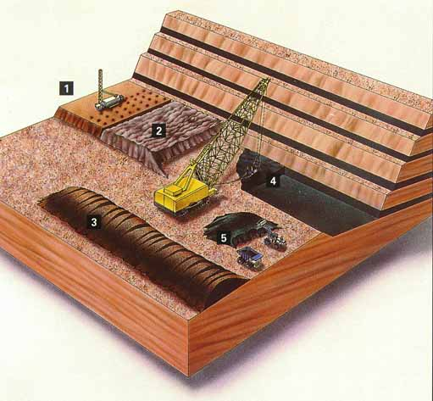
Dragline Operation

Slide 23
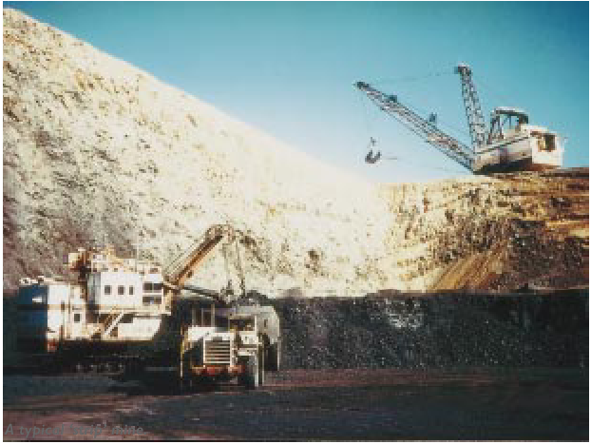
Surface Mining Operation

Slide 24
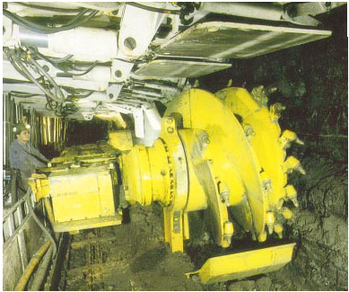
Underground Mining Operation

Slide 25
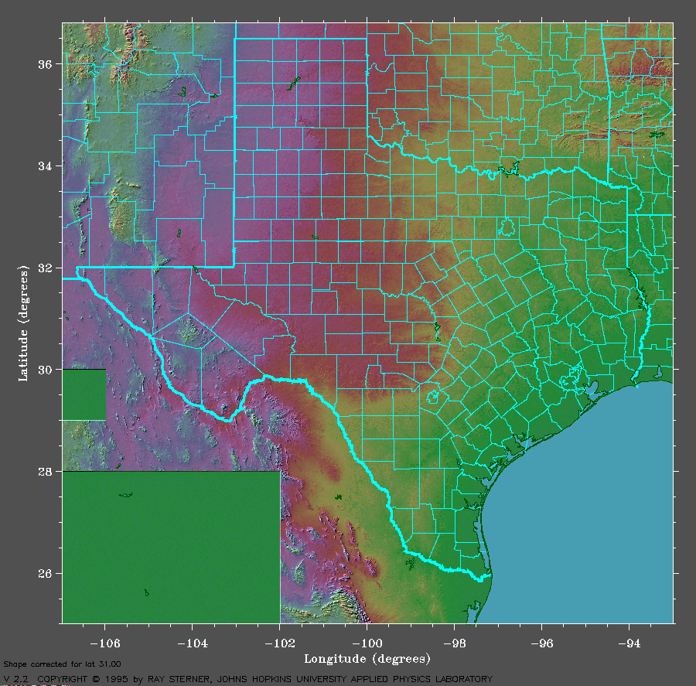
Coal Mining in Texas
LEGEND
>8 M Tons/year
< 8 M Tons/year
1
2
3
1. Thermo (TXU)
2. S. Hallsville (Sabine)
3. Martin Lake (TXU)
4. Big Brown (TXU)
5. Jewett (NW Resources)
6. Sandow (Alcoa)
7. San Miguel (SMEC)
5
4
6
7

Slide 26
Coal Processing
and Quality

Slide 27
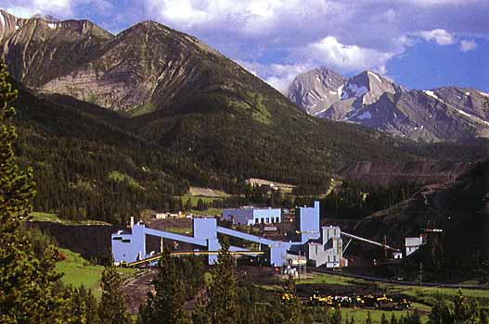
Coal Preparation

Slide 28
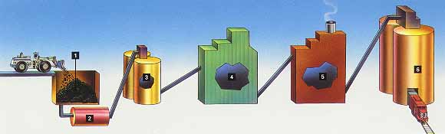
Coal Preparation process
Coal Stockpile
Raw coal silo
Crushing and screening
Thermal dryers
Clean coal silos
Coal pile to silo via reclaim tunnel
Constant supply to plant
Cyclones
Spirals
Flotation
Reduce moisture
Increase Btu
May add:
Encrustation agent
Antifreeze

Slide 29
Coal Quality Analysis
PROXIMATE ANALYSIS
(Behavior of coal when burned)
ULTIMATE ANALYSIS
(Coal Composition)
OTHER ANALYSES
Moisture
Volatile matter
Ash
Heating Value (Btu/lb)
Sulfur
Carbon
Hydrogen
Oxygen
Nitrogen
Ash
HGI
Fixed Carbon
Ash Fusion
Caking index
Gray-King Assay
Trace elements (HAPs)

Slide 30
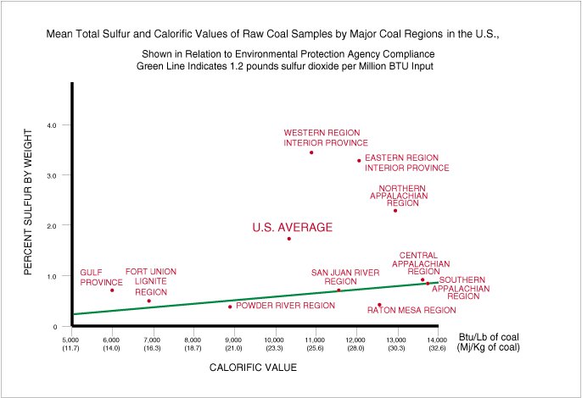
Quality Values for US Coal

Slide 31
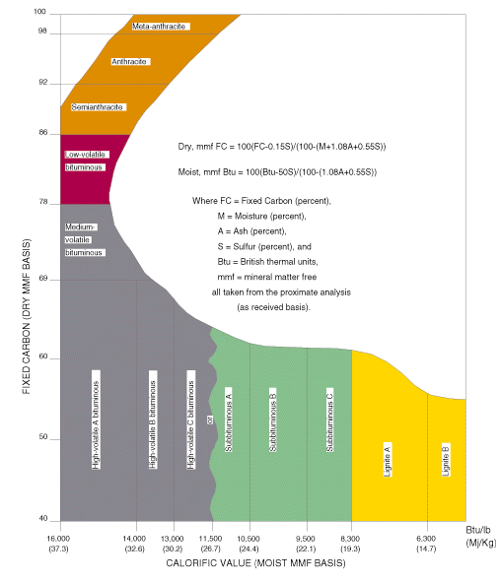
Fixed Carbon and Calorific Value

Slide 32
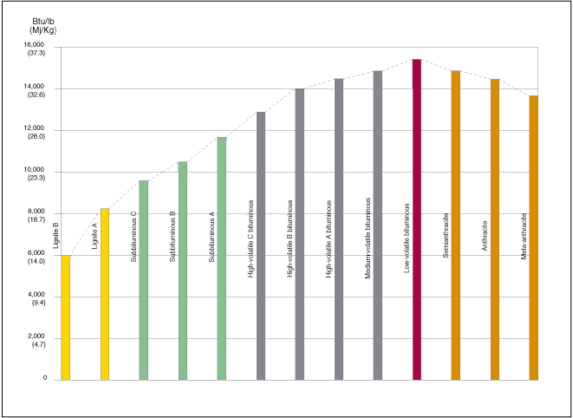
Calorific Value (Btu/lb)

Slide 33
SO2 Emission Allowances
    The federal Clean Air Act Amendments of 1990 call for a 10 million ton annual reduction in national sulfur dioxide (SO2) emissions from 1980 levels.
    The law creates a new tradeable commodity, the SO2 emission allowance. Each allowance represents an authorization to emit one ton of SO2 (i.e., a unit that emits 5,000 tons of SO2 must hold at least 5,000 allowances that are usable that year).
    By avoiding the emission of SO2 with a renewable technology, utilities will both earn and save tradeable emission allowances. These emission allowances have a real market value.

Slide 34
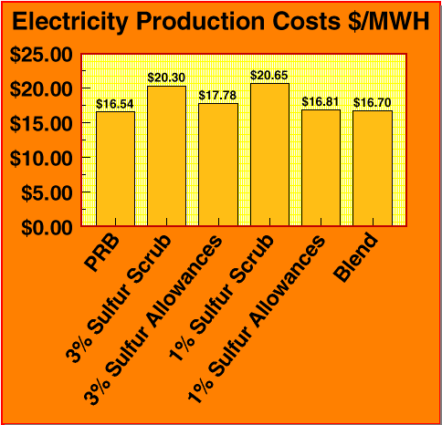
SO2 Options for a Power Station

Slide 35
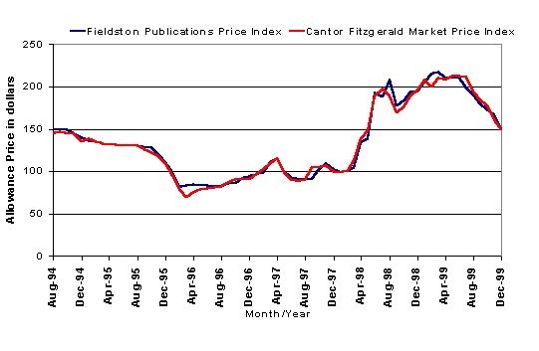
SO2 Emission Allowance Trading

Slide 36
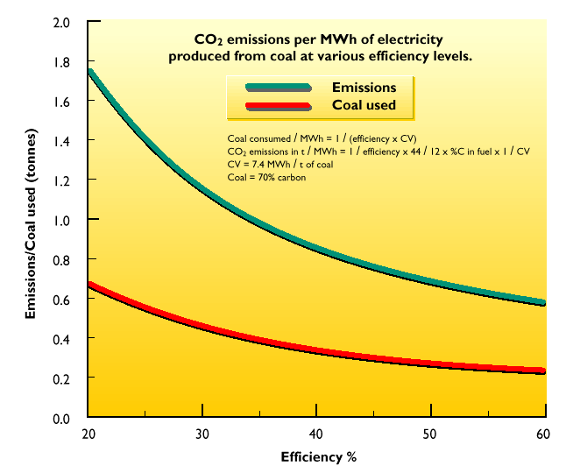
CO2 Emissions

Slide 37
Coal Transportation

Slide 38
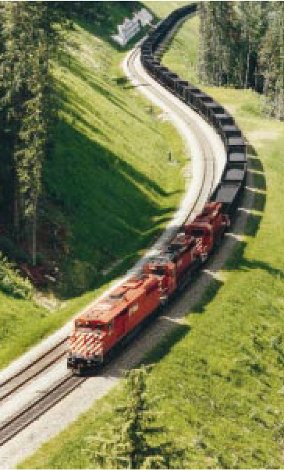
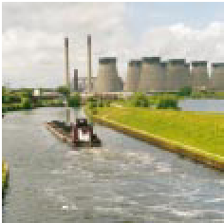
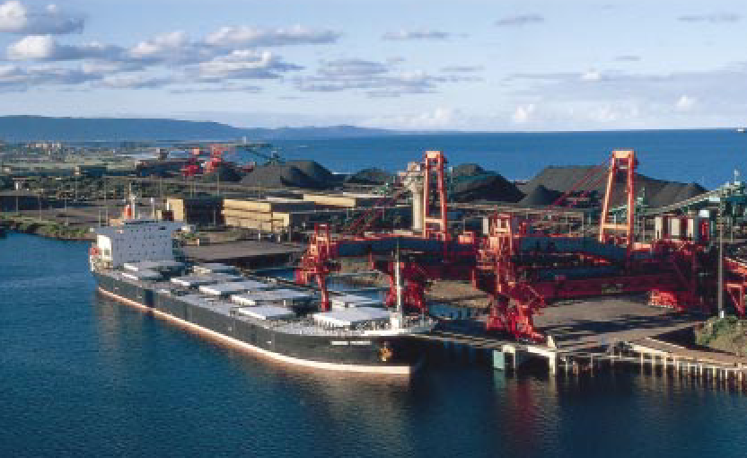
Coal Transportation

Slide 39
US Coal Transportation Summary
75% of coal shipments are handled by railroads and barges
Coal movements are frequently "intermodal”
The methods of transportation and shipping distance greatly
influence the total cost of coal to the consumer

Slide 40
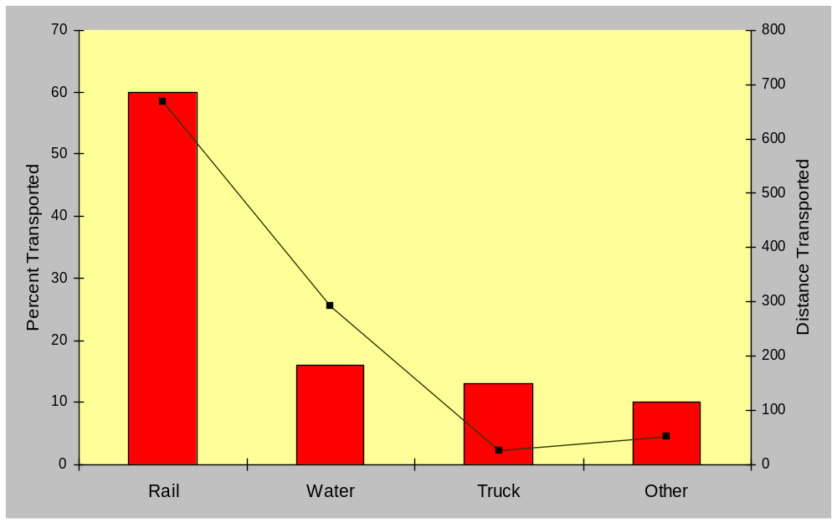
Coal Transportation Modes

Slide 41
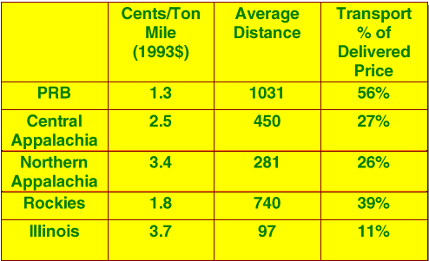
US Coal Transportation Costs

Slide 42
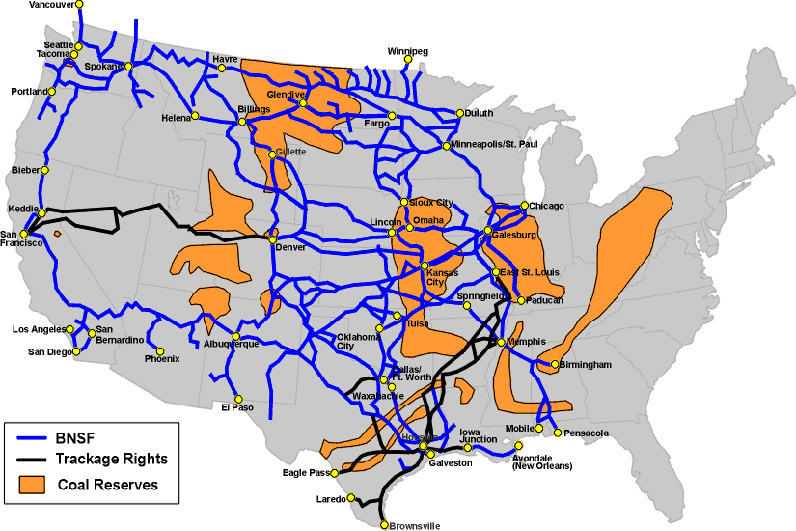
Burlington Northern Network

Slide 43
Intermodal Transport
Mine
Dock
Dock
Plant
Rail
Barge
Rail
Issues:
Bad order cars - Railcars requiring repair
Derailments - Loss of load
Stragglers - Railcars separated from train

Slide 44
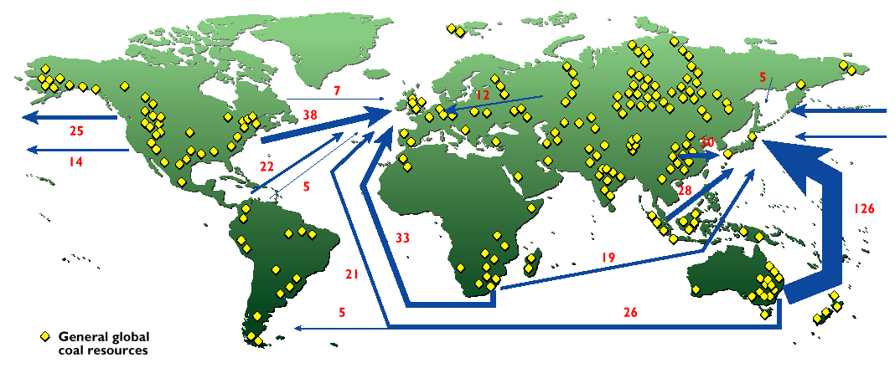
World Coal Trade, 1997 (million tons)

Slide 45
Uses of Coal

Slide 46
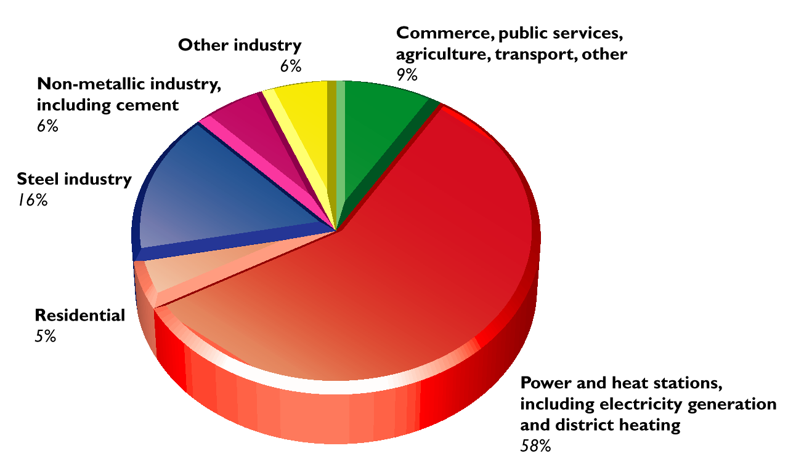
Uses of Coal

Slide 47
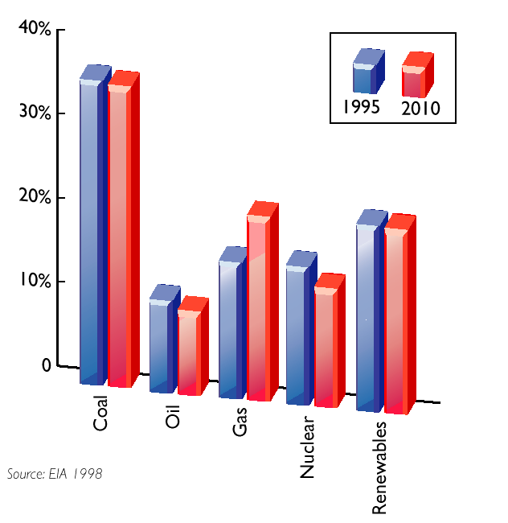
World Electricity Production by Fuel

Slide 48
US Coal Consumption (1998)
6%
3%
7%
Electric Power
Exports
Coke Plants
82%
Other Industrial
Residential
Other

Slide 49
Major US Coal Utilities (1999)
Rank
Company
M tons/year
1
Southern Company
85.4
2
American Electric Power (AEP)
75.2
3
Tennessee Valley Authority (TVA)
51.9
4
Cinergy
35.5
5
Allegheny Power
30.0
6
First Energy
28.9
7
Xcel Energy
26.9
8
Ameren
25.3
9
Pacificorp
24.2
10
Detroit Edison
24.2
11
Duke Power
22.3
12
GPU Service Corp
21.6
13
Unicom
19.1
14
LG&E Energy
18.4
15
Texas Utilities Electric
18.1
16
Virginia Power
16.4
17
Carolina Power and Light
16.0
18
Reliant (HPL)
12.7
19
Midamerican Energy
12.2
20
Entergy
11.8

Slide 50
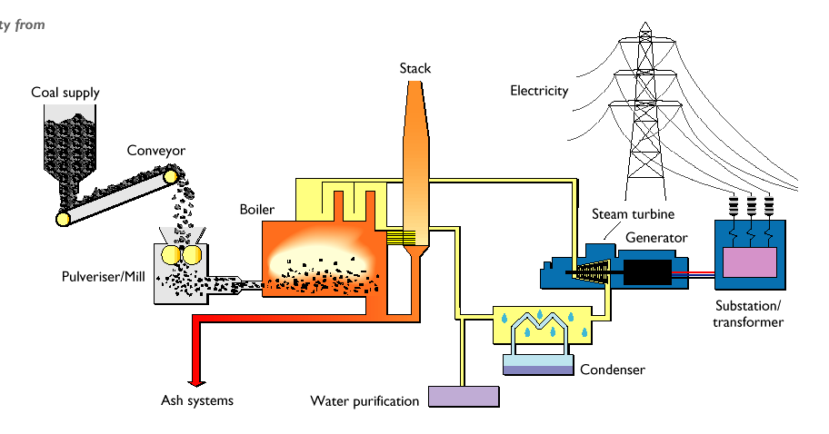
Electricity Generation

Slide 51
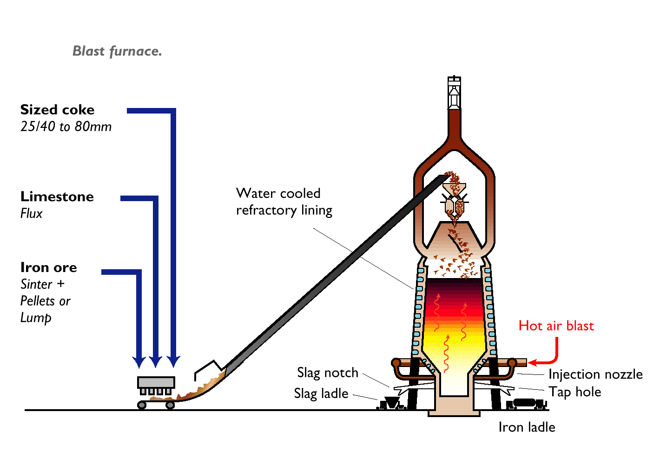
Steel Manufacturing

Slide 52
Marketing
Allegro Coal

Slide 53
Trends in US Coal Mining
      Market Factors
      Lower coal prices
      Cheaper rail transport - railroad deregulation
      Shorter term contracts - power industry deregulation
      Industry Response
      Fewer, but larger, coal companies
      Fewer coal mines, but larger average mine size
      Western mines increasing share of total production
      Increased importance of surface mines

Slide 54










Potential Customers
Producers/
Refiners
Traders/
Transporters
Utilities/
Consumers

Slide 55



The Competition
--- Yes
--- No
--- No

Slide 56
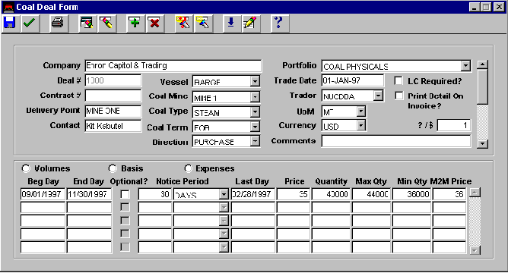
Nucleus Coal Trading

Slide 57
Allegro Coal Enhancements
Capture specs for coal quality
- Moisture content - Sulfur, mercury/chloride
- Ash, size, volatile matter
Capture lab analysis results
- Input as actuals
- Calculate price adjustments on contract
Capture coal processing/blending
- Variable quality inputs forming a single blended output
Enhance scheduling for coal
- Train and railcar tracking, Railroad EBBs

